Slide 1
Regularization
Przemysław Sekuła

Slide 2
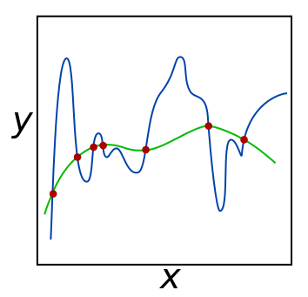
Regularization – problem Description
In case of overcomplicated function we may suffer from overfitting…
… but in case of too simple function we may not encompass the variety of the real world

Slide 3
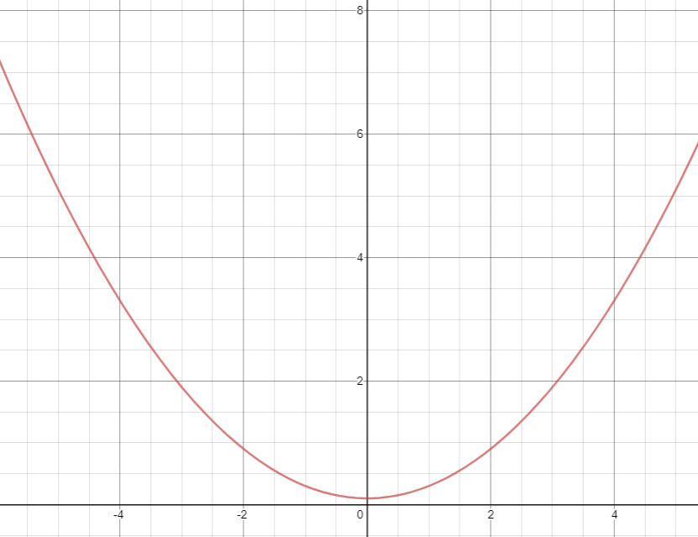
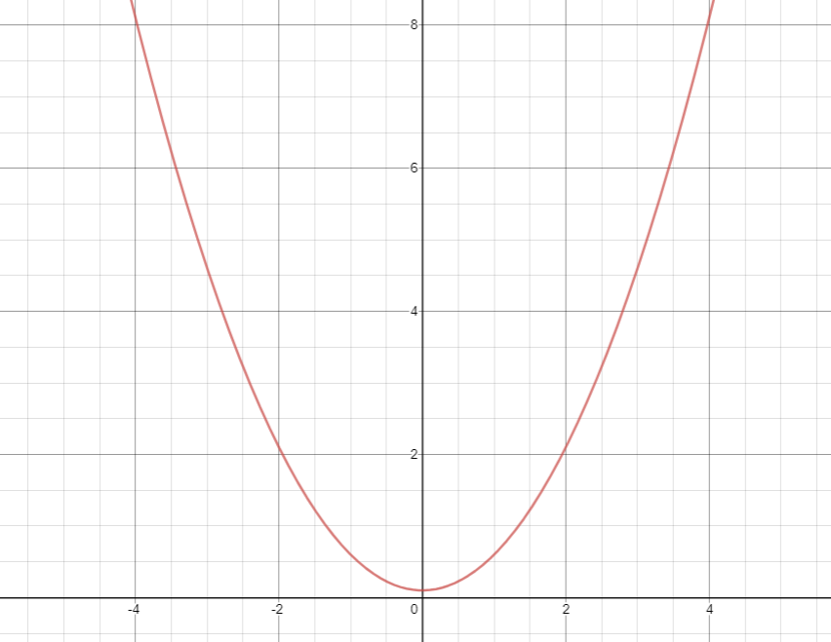
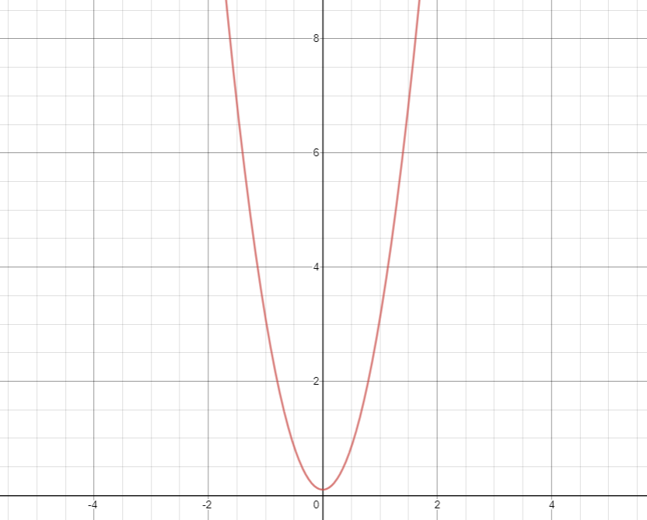
How to keep function smooth (1/2)
https://www.desmos.com/calculator/cz7iiue5x6
y =Θ₀ + Θ₁x + Θ₂x²
Intuition: Keep your parameters low
Θ₂ = 0.2
Θ₂ = 0.5
Θ₂ = 2

Slide 4
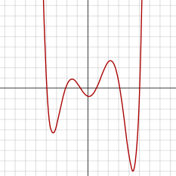
How to keep function smooth (2/2)
Intuition: Set some parameters to 0
y =Θ₀ + Θ₁x + Θ₂x² +Θ₃x³ +Θ₄x⁴ +Θ₅x⁶ +Θ₆x⁶
y =Θ₆x⁶

Slide 5
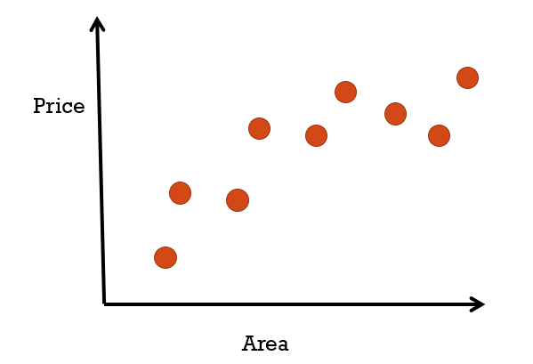
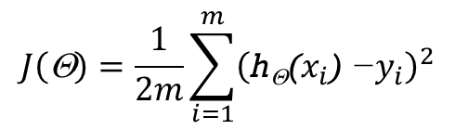
Regularization – Intuition
y = Θ₀ + Θ₁x + Θ₂x²
$$J\left(\text{Θ}\right)=\frac{1}{2m}\sum_{i=1}^{m}{{\left(\text{h}\text{Θ}\text{(}x_{i}\text{) −}y_{i}\right)}^{2}}$$

Slide 6
Regularization – Intuition
y = Θ₀ + Θ₁x + Θ₂x² y = Θ₀ + Θ₁x + Θ₂x² + Θ₃x³ + Θ₄x⁴
$$J\left(\text{Θ}\right)=\frac{1}{2m}\sum_{i=1}^{m}{{\left(\text{h}\text{Θ}\text{(}x_{i}\text{) −}y_{i}\right)}^{2}}$$

Slide 7
Regularization – Intuition
y = Θ₀ + Θ₁x + Θ₂x² y = Θ₀ + Θ₁x + Θ₂x² + Θ₃x³ + Θ₄x⁴
$$J\left(\text{Θ}\right)=\frac{1}{2m}\sum_{i=1}^{m}{{\left(\text{h}\text{Θ}\text{(}x_{i}\text{) −}y_{i}\right)}^{2}}$$

Slide 8
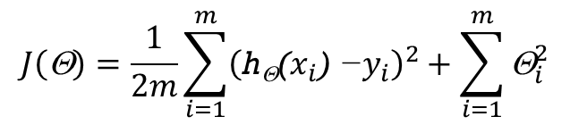
Regularization – Intuition
y = Θ₀ + Θ₁x + Θ₂x² y = Θ₀ + Θ₁x + Θ₂x² + Θ₃x³ + Θ₄x⁴
$$J\left(\text{Θ}\right)=\frac{1}{2m}\sum_{i=1}^{m}{{\left(\text{h}\text{Θ}\text{(}x_{i}\text{) −}y_{i}\right)}^{2}}+\sum_{i=1}^{m}{{\text{Θ}}_{i}^{2}}$$

Slide 9
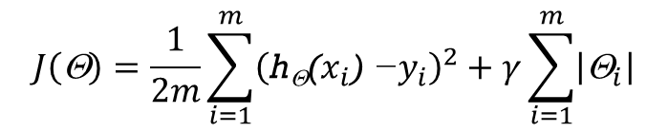
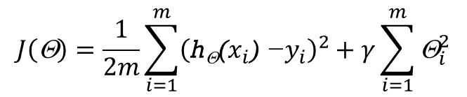
L1 and L2 Regularization
L2 Regularization:
L1 Regularization
$$J\left(\text{Θ}\right)=\frac{1}{2m}\sum_{i=1}^{m}{{\left(\text{h}\text{Θ}\text{(}x_{i}\text{) −}y_{i}\right)}^{2}+γ\sum_{i=1}^{m}{{\text{Θ}}_{i}^{2}}}$$
$$J\left(\text{Θ}\right)=\frac{1}{2m}\sum_{i=1}^{m}{{\left(\text{h}\text{Θ}\text{(}x_{i}\text{) −}y_{i}\right)}^{2}+γ\sum_{i=1}^{m}{\left|{\text{Θ}}_{i}\right|}}$$

Slide 10
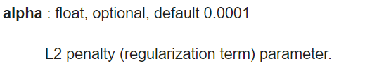
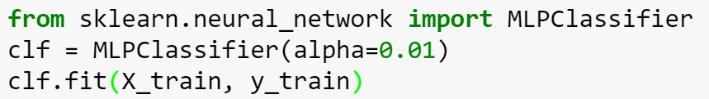
Regularization in Sci-kit learn
Is usually build in ☺

Slide 11
Thank you Q & A

